Slide 1



ML-Based Predictive Cloud Resource Management
Using Anomaly Detection and Adaptive Auto-Scaling
Platform: AWS EC2 (Ubuntu, t3.micro, eu-north-1)
Neeraj Apraj | 16010123212 |
Oshan Shah | 16010123223 |
Advanced Cloud Computing | Zaheed Shaikh

Slide 2
Problem and Objective
Reactive scaling is late
VMs take about 5 minutes to boot. Traffic spikes hit before new capacity is ready, so latency rises and SLAs are missed.
Over-provisioning wastes
Keeping spare VMs always on avoids slowdowns but burns money and energy during quiet periods.
Our approach
Forecast load 10 minutes ahead, detect anomalies, and scale adaptively, falling back to reactive control when the forecast cannot be trusted.

Slide 3
System Architecture
AWS EC2 (Ubuntu, t3.micro)
ML Engine
Anomaly Detector
(Isolation Forest)
Users / Traffic
Web App on VMs
Metrics Collector
Scaling Decision Engine
Cloud API: add / remove VMs
Forecaster
(Random Forest, 10 min)
Feedback loop: recent forecast error sets the adaptive safety buffer (5 to 30%)
Scaling actions are simulated with a 5-minute VM boot delay; the ML models run on the real EC2 VM.

Slide 4
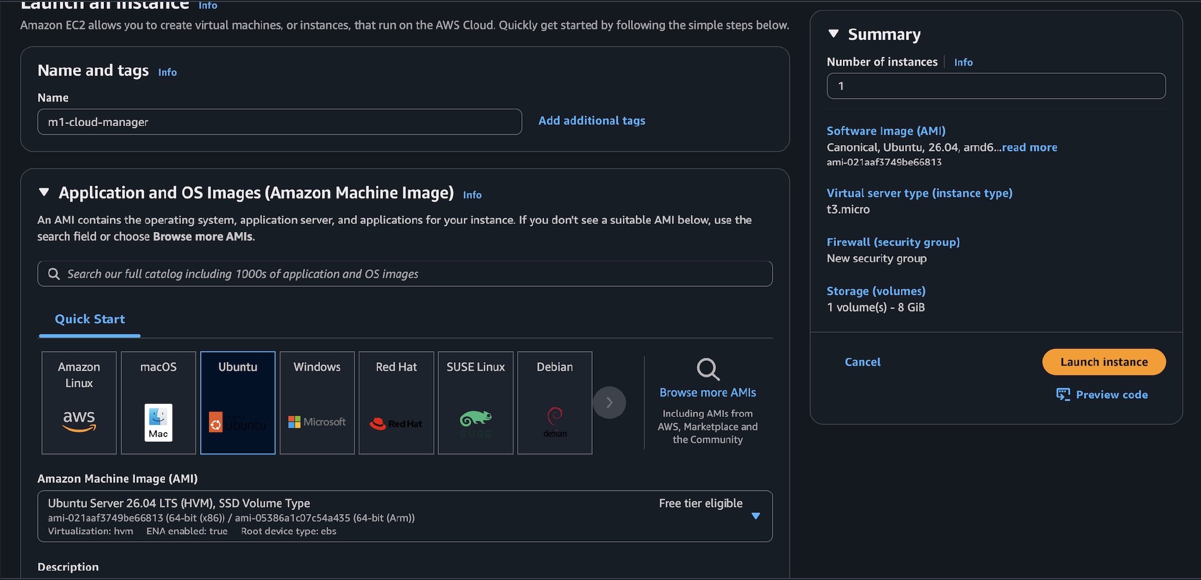
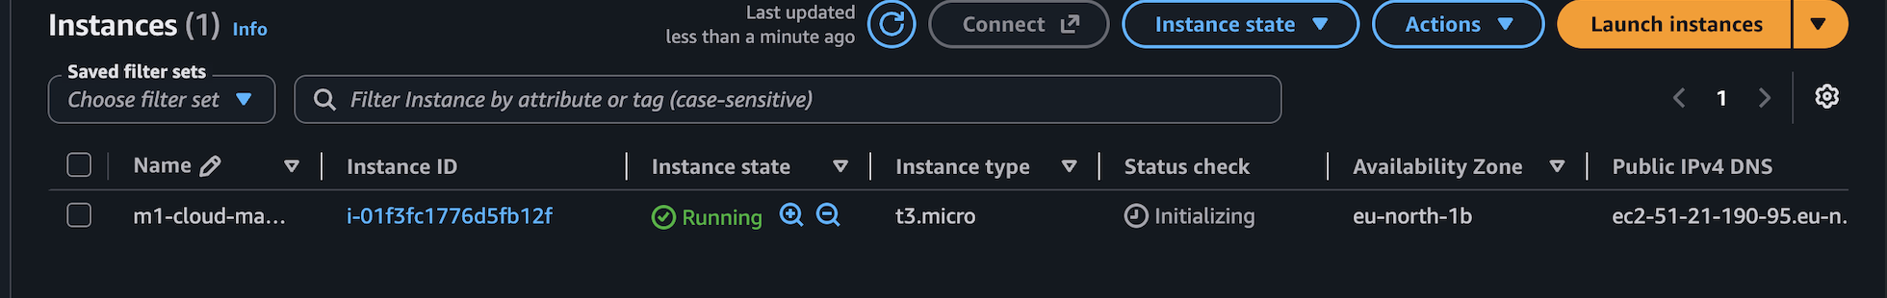
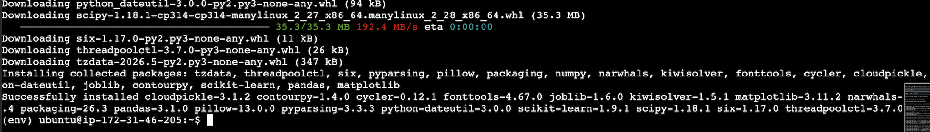
Implementation on AWS EC2
Instance running in eu-north-1 (Stockholm)
Python environment installed on the VM
EC2 launch: Ubuntu Server 26.04 LTS, t3.micro
Python venv: numpy, pandas, scikit-learn, matplotlib
Workload, models and simulator run in one script (manager.py)
Browser SSH (EC2 Instance Connect); results served over port 8000

Slide 5
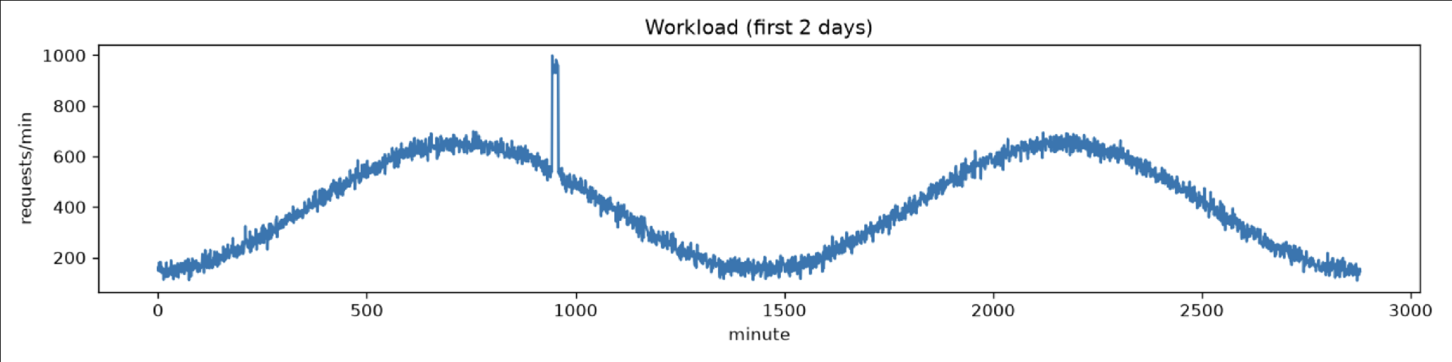
Input Data and Features
Workload
Generated 7-day trace, 1-min steps: daily cycle, noise, 12 random spikes.
Features
Lags (1 to 30 min), rolling mean/std, rate of change, time-of-day sin/cos.
Split
70% train (7,028 rows), 30% test (3,012), chronological to avoid leakage.

Slide 6
Algorithms and Prediction Horizon
Forecaster: Random Forest
Handles non-linear patterns, trains fast, needs little tuning. Predicts load 10 minutes ahead. Baselines: naive "future = now" and reactive scaling.
Anomaly detector: Isolation Forest
Unsupervised, so no labelled anomalies are needed. Uses load, rolling std and rate of change to flag sudden spikes (2% contamination).
Why a 10-minute horizon? A VM needs about 5 minutes to boot, so the forecast must look further ahead than that. Longer horizons lose accuracy.

Slide 7
Adaptive Auto-Scaling Design
1 Forecast
Predict load 10 minutes ahead from the latest metrics.
2 Add buffer
Headroom of 5 to 30%, set by recent forecast error (adaptive).
3 Check anomaly
If flagged: go reactive with 30% extra headroom.
4 Scale safely
Scale in 1 VM per minute; keep a minimum of 2 VMs.
VMs needed = load / (100 req/min x 0.7 target utilization)
ML mode = max( reactive need, forecast x (1 + adaptive buffer) )
Assumptions: 5-min VM boot | $0.05 per VM-hour | 100 to 200 W per VM | SLA violation = latency > 500 ms

Slide 8
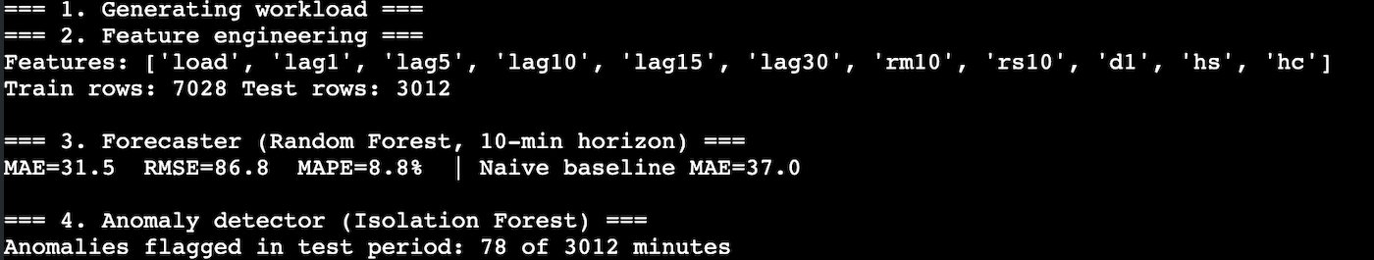
Prediction Accuracy
31.5
MAE (naive baseline: 37.0)
15%
lower error than naive
8.8%
MAPE
78
anomaly minutes flagged of 3,012
RMSE (86.8) is far above MAE because errors concentrate at the random spikes, which no model can predict in advance.
Output from the EC2 instance

Slide 9
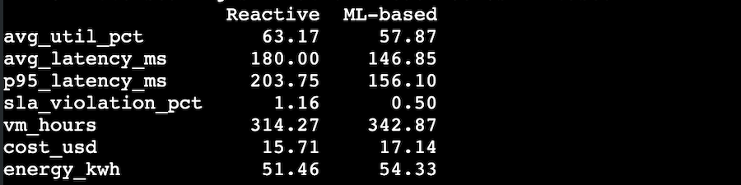
Results: Reactive vs ML-Based
Metric | Reactive | ML-based | Change
Avg utilization | 63.2% | 57.9% | -5.3 pts
Avg latency | 180.0 ms | 146.9 ms | -18%
p95 latency | 203.8 ms | 156.1 ms | -23%
SLA violations | 1.16% | 0.50% | -57%
VM-hours | 314.3 | 342.9 | +9.1%
Cost | $15.71 | $17.14 | +9.1%
Energy | 51.46 kWh | 54.33 kWh | +5.6%
-57%
SLA violations
-23%
p95 latency
+9%
cost for the extra headroom
Better latency and SLA compliance, paid for with slightly higher cost and energy.

Slide 10
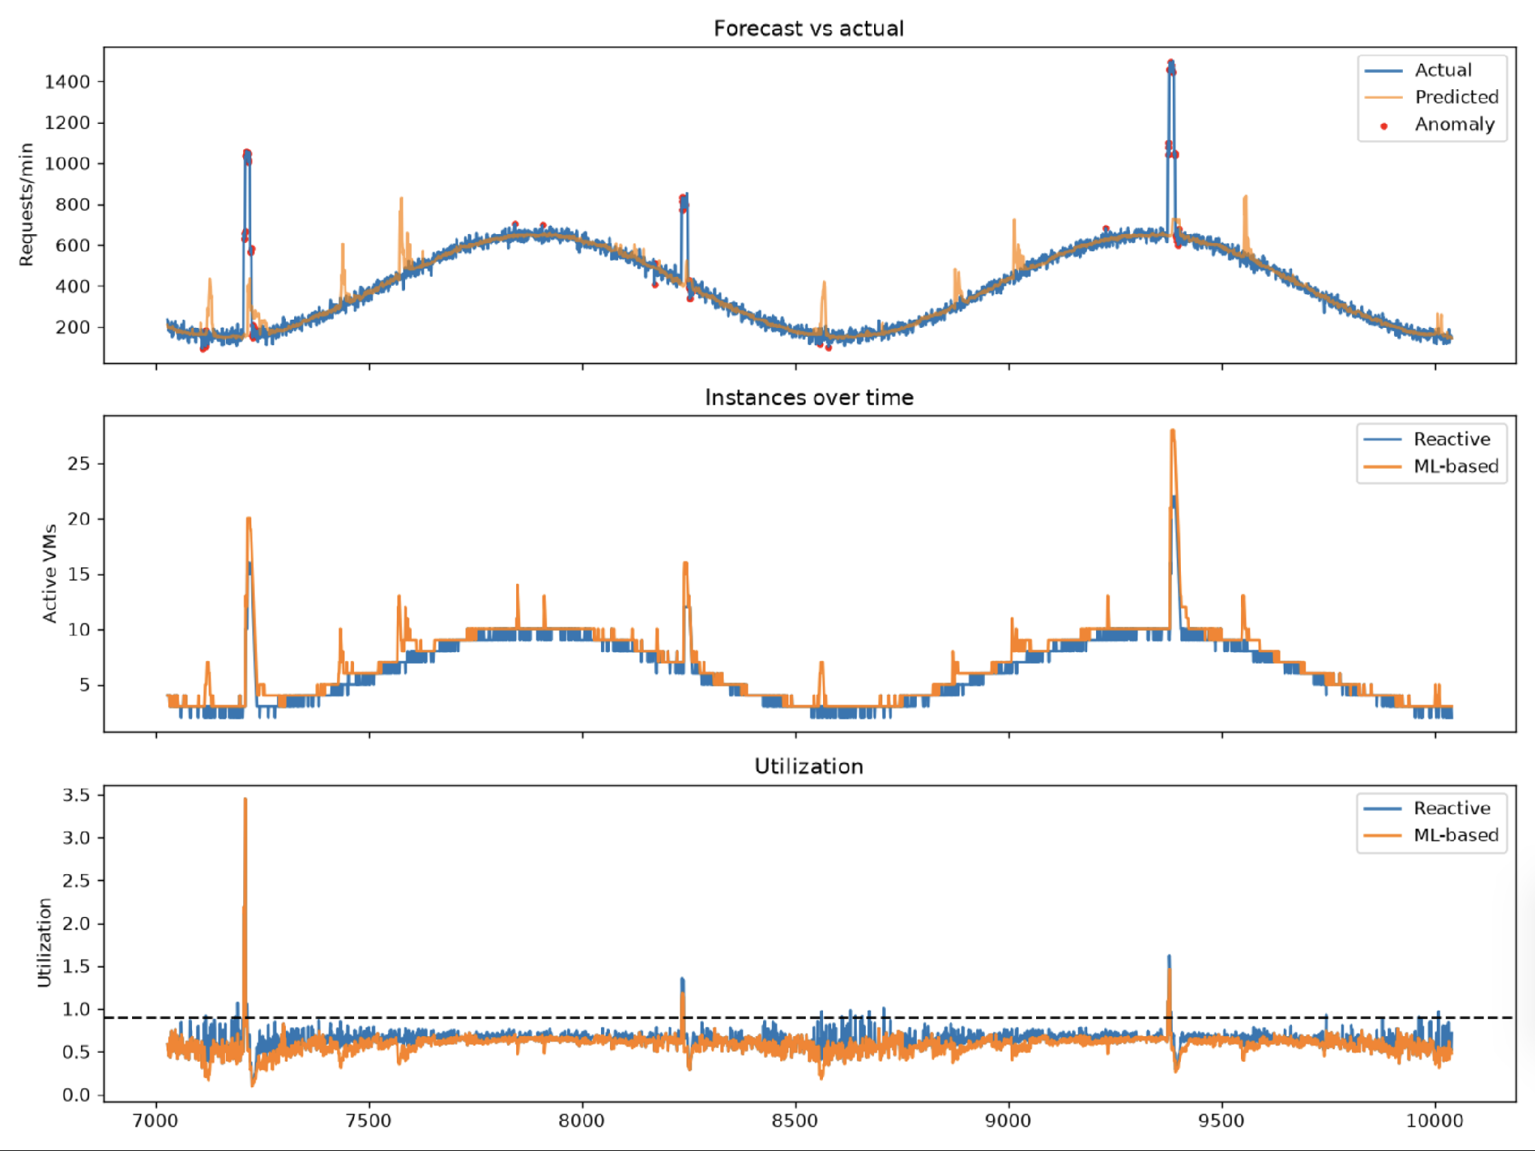
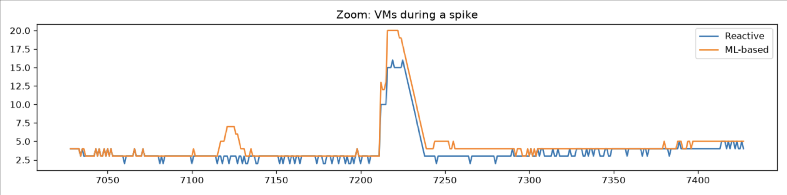
Forecast, Scaling and Spike Behaviour
Zoom: VMs during a spike
ML (orange) adds VMs before the daily peak; reactive (blue) follows after
Red dots mark anomalies flagged on spikes
Spikes start at random, so the 5-min boot delay still causes some SLA misses

Slide 11
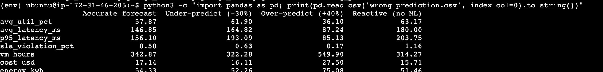
What If the Prediction Is Wrong?
Under-predict (-30%)
p95 latency 156 to 193 ms, SLA 0.50% to 0.63%, cost -6%. Still better than reactive (1.16%).
Over-predict (+40%)
Best latency (85 ms) but cost $27.50 (+60%), energy +38%, utilization only 36%.
Safeguards
Reactive floor, anomaly fallback, adaptive buffer, gradual scale-in, retraining on drift.
Wrong-prediction experiment output from the EC2 instance

Slide 12
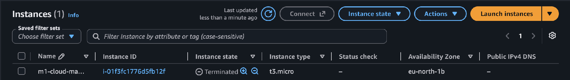
Conclusion and Future Work
Conclusion
A 10-minute Random Forest forecast plus anomaly-aware scaling cut SLA violations by 57% and p95 latency by 23%, at about 9% more cost.
Future work
Add an LSTM forecaster, replay real Azure/Google traces, and move from simulated to live scaling with boto3 and Auto Scaling Groups.
EC2 instance terminated after the experiments

